Slide 1


AUTOMATIC
TOILET FLUSHERS
By
S.DEEPIKA(23EIR016)
M.GOPIKA(23EIR032)
S.MOOHITH(23EIR199)
Mentor:
N.INDHU
Assistant Professor
Department of EIE

Slide 2
Introduction
Nowadays, people care more about hygienic and cleanness, especially during pandemic outbreak times. When you go to a public restroom in a shopping mall, you need to turn on the faucet every time. After so many people using it, so dirty and germs will pass to you.In this presentation we will present to you a idea of us.

Slide 3
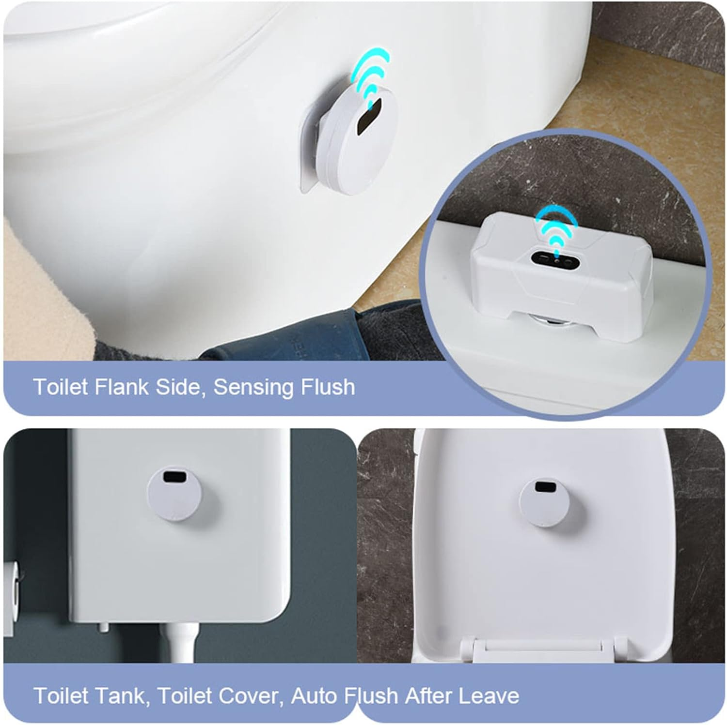
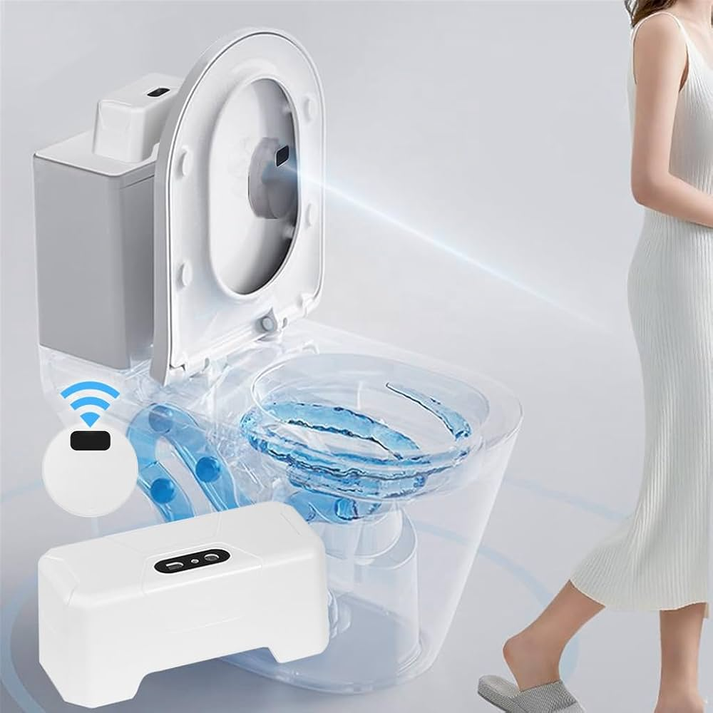
AUTOMATIC TOILET FLUSHERS
Automatic toilet flusher uses active infrared sensor technology which uses the emission and reception of infrared beams to detect the presence and movement of objects or people in their field of detection.
When the sensor detected the body, it is ready to work. When people leave, it flushes water automatically. If usage time less than 1min and 9s per flush if usage time more than 1 min,thus saving excess water usage.

Slide 4
FOUR KEY PARTS OF AUTOMATIC TOILET FLUSHER
1.INFRARED SENSOR
2.SOLENOID VALVE
3.POWER SENSOR
4.WATERPROOF CONNECTOR CABLES

Slide 5
HOW DO AUTOMATIC FLUSH TOILETS WORK
The infrared sensor has infrared LEDs (light-emitting sensor detects when infrared light is reflected by the user.
After the detection, the sensor will give a pulse signal to the solenoid valve to let it open.

Slide 6
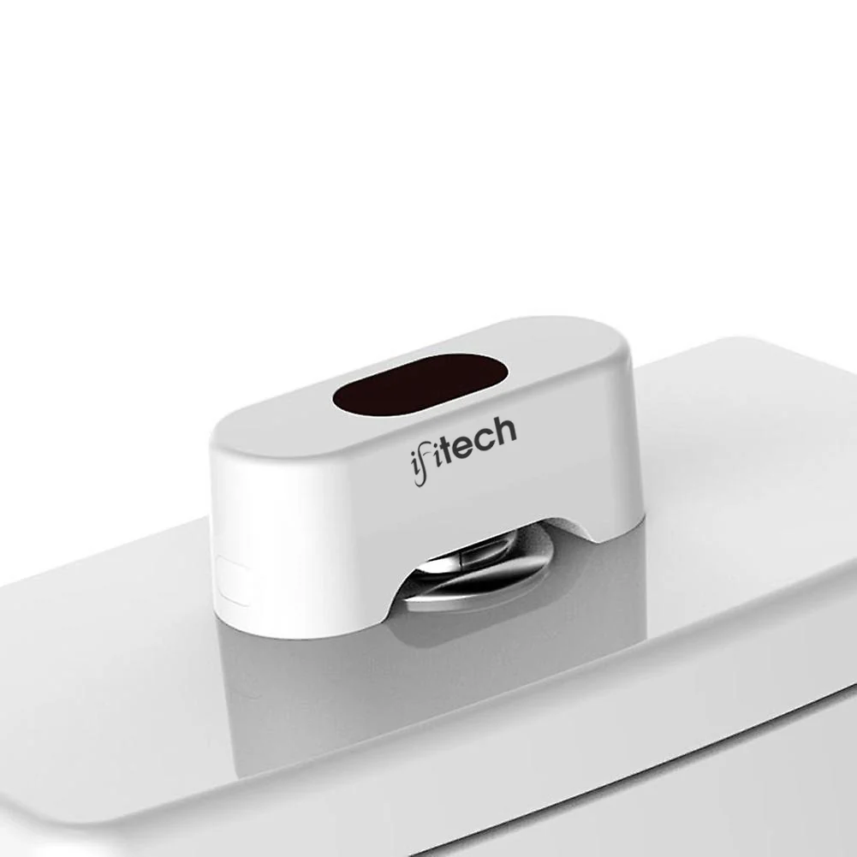
Existing Models

Slide 7
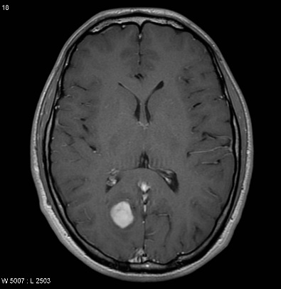
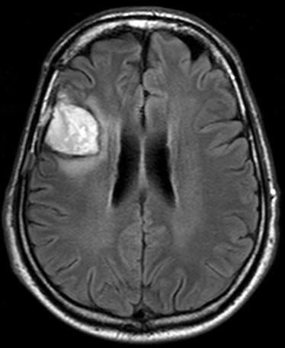
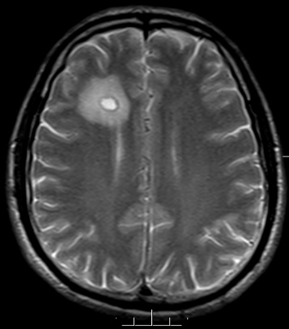
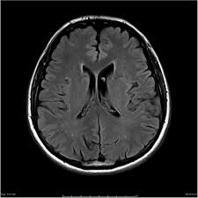
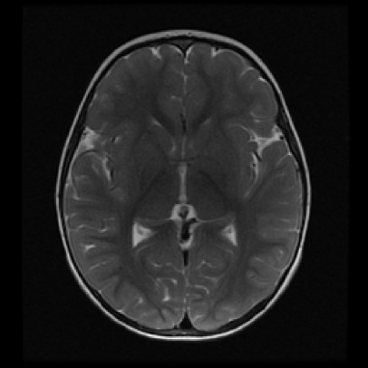
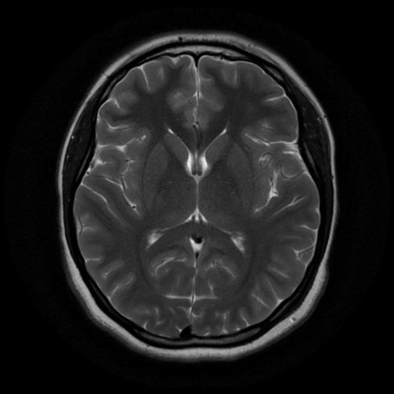
Sample Images from the database
Images with Tumor
Images without Tumor

Slide 8
Local Binary Pattern(LBP)
It is simple but very efficient texture operator
It labels the pixels of an image by thresholding the neighbourhood of each pixel
the resultant will be a binary number

Slide 9
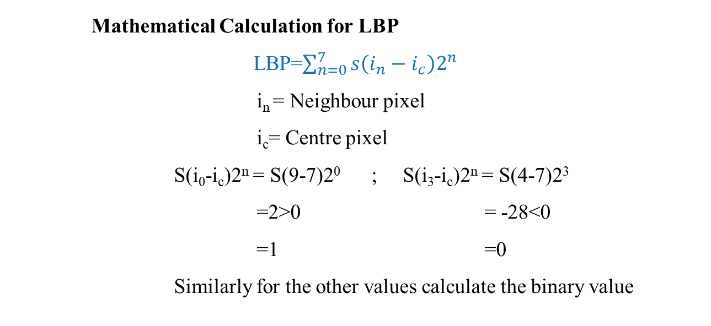
Mathematical Representation of LBP
9i₀ | 5i₁ | 7i₂
6i₇ | 7i_{c} | 4i₃
3i₆ | 8i₅ | 2i₄
1 | 0 | 1
0 |  | 0
0 | 1 | 0
 | 164
3x3 pixels
Binary (10100100)₂
Decimal
Mathematical Calculation for LBP
LBP=$\sum_{n=0}^{7}{s\left(i_{n}−i_{c}\right)2^{n}}$
i_{n} = Neighbour pixel
i_{c}= Centre pixel
S(i₀-i_{c})2^{n} = S(9-7)2⁰ ; S(i₃-i_{c})2^{n} = S(4-7)2³
=2>0 = -28<0
=1 =0
Similarly for the other values calculate the binary value

Slide 10

LBP contd….
s$\left(z\right)=\left\{\begin{aligned}0, z<0 \\ &1, z≥0\end{aligned}\right.$
Binary Number generated
1 | 0 | 1
0 |  | 0
0 | 1 | 0
1 | 0 | 1 | 0 | 0 | 1 | 0 | 0
Decimal Value =0*2⁰+0*2¹+1*2²+0*2³+0*2⁴+1*2⁵+0*2⁶+1*2⁷
=4+32+128
=164

Slide 11
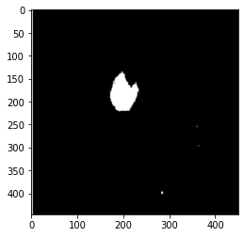
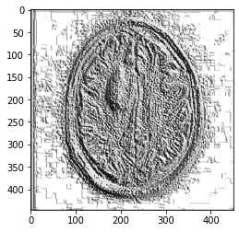
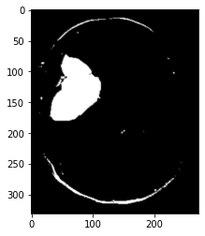
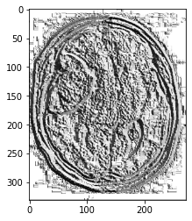
Local Binary Pattern(LBP)
S.No | LBP Image | Image After Applying Threshold Value
01
02

Slide 12
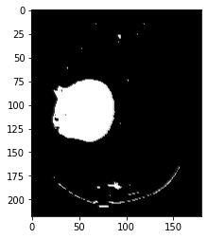
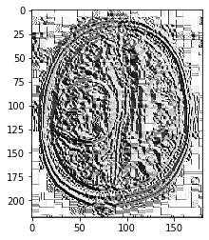
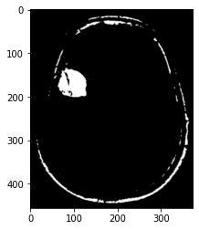
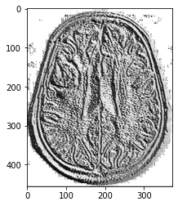
Ctd…
S.No | LBP Image | Image After Applying Threshold Value
03
04

Slide 13
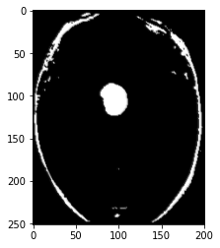
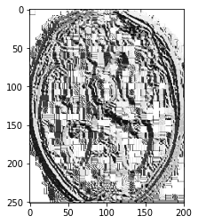
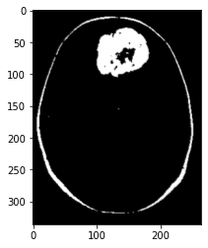
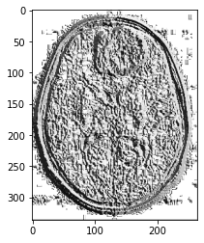
Ctd…
S. No | LBP Image | Image after applying threshold value
05
06

Slide 14

Dice Similarity Coefficient
The dice coefficient "DSC" is:
A being the predicted tumor region
B being the ground truth
Dice similarity coefficient, which is a measure of how well two contours overlap
The dice value ranges from 0 to 1
0 – mismatch
1 - match

Slide 15
Results
S. No | Image No | DSC-Deep Network | DSC-LBP
01 | 1 | 0.716 | 0.792
02 | 2 | 0.623 | 0.759
03 | 3 | 0.813 | 0.801
04 | 8 | 0.833 | 0.872
05 | 254 | 0.794 | 0.782
06 | 243 | 0.777 | 0.787
07 | 10 | 0.555 | 0.626
08 | 11 | 0.745 | 0.768
09 | 12 | 0.753 | 0.753
10 | 164 | 0.775 | 0.770
11 | 114 | 0.725 | 0.790
12 | 97 | 0.786 | 0.776

Slide 16
Work Plan
Completed – CNN based Segmentation
February – LBP based Segmentation
March – Hybridization
April – Publication and Report

Slide 17
References
Hu, K., Gan, Q., Zhang, Y., Deng, S., Xiao, F., Huang, W., ... & Gao, X. (2019). Brain tumor segmentation using multi-cascaded convolutional neural networks and conditional random field. IEEE Access, 7, 92615-92629.
Vaibhavi, P., & Rupal, K. (2018). Brain Tumor Segmentation Using K-means–FCM Hybrid Technique. In Ambient Communications and Computer Systems (pp. 341-352). Springer, Singapore.
Havaei, M., Davy, A., Warde-Farley, D., Biard, A., Courville, A., Bengio, Y., ... & Larochelle, H. (2017). Brain tumor segmentation with deep neural networks. Medical image analysis, 35, 18-31.

Slide 18
THANK YOU

